Slide 1

RUNGTA COLLEGE OF DENTAL SCIENCES & RESEARCH
TITLE OF THE TOPIC :
Biological Consideration of Maxillary Edentulous Arch
DEPARTMENT OF PROSTHODONTICS AND CROWN & BRIDGE

Slide 2
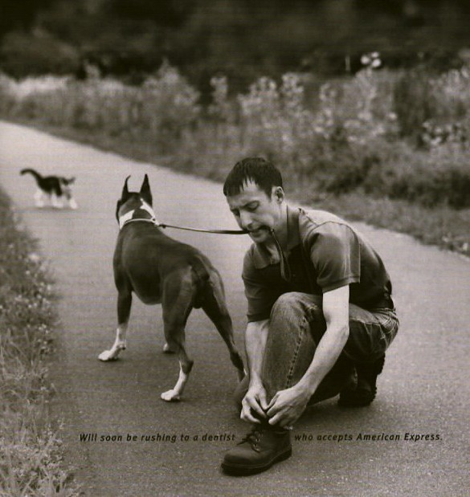

Slide 3
Specific learning Objectives
At the end of this presentation the learner is expected to know ;
Core areas* | Domain ** | Category #
Introduction, | Cognitive | Must Know
Important landmarks of maxillary arch | Cognitive | Must Know
Take home message | Cognitive | Must Know
References | Cognitive | Must Know

Slide 4
Table of Content
Introduction to maxillary arch landmarks
Residual alveolar ridge
Labial & Buccal Frenum
Labial & Buccal vestibule
Incisive papilla
Palatal Rouge area
Mid palatine suture
Fovea palatine
Posterior palatal seal
Maxillary tuberosity
Hamular notch
Summary & take home message
References

Slide 5
Introduction
Knowledge of oral anatomy helps the operator in understanding the landmarks that serve as positive guides in Prosthodontic procedures.

Slide 6
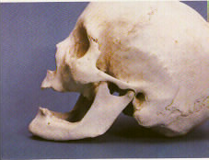
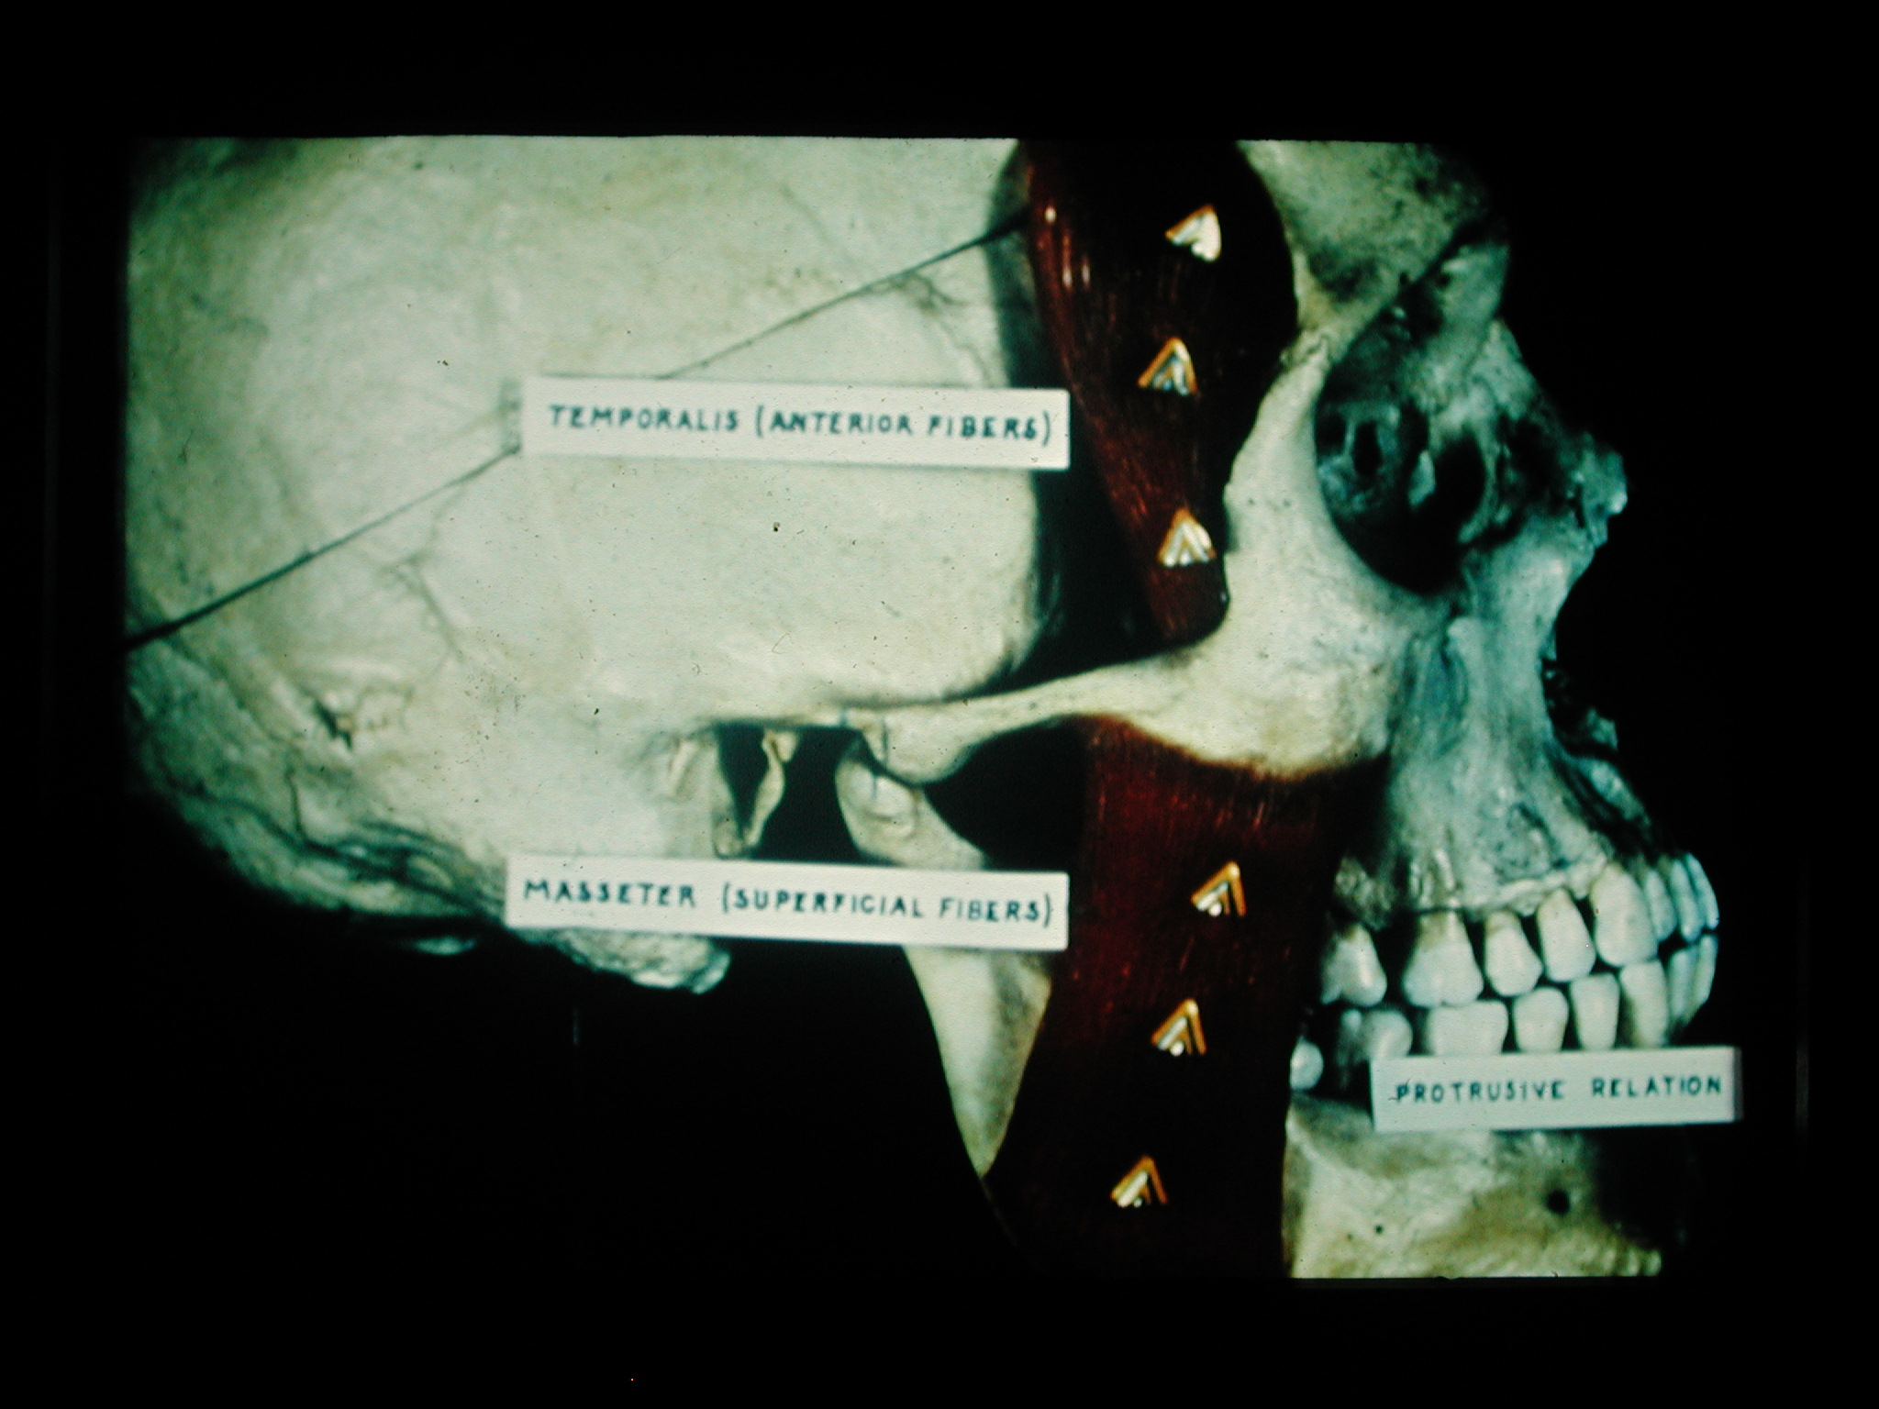

Slide 7
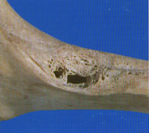
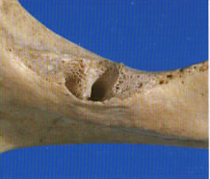
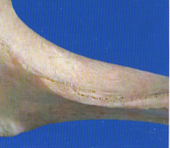
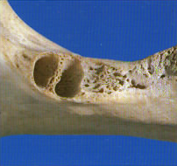

Slide 8
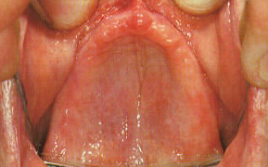
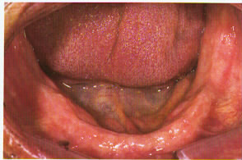
Maxillary and Mandibular Edentulous Foundations

Slide 9
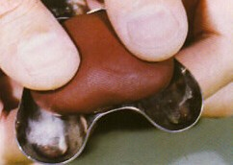

Slide 10
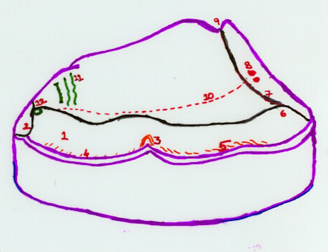
MAXILLARY EDENTULOUS FOUNDATIONS:
Anatomical Land Marks
Residual alveolar ridge
Labial Frenum
Buccal frenum
Labial vestibule
Buccal vestibule
Incisive papilla
Rouge
Mid palatine suture
Fovea palatine
Posterior palatal seal
11. Maxillary tuburosity
12. Hamular notch
10.
1
8
7.
9.
12.
6.
2.
4
3
5.
11.

Slide 11
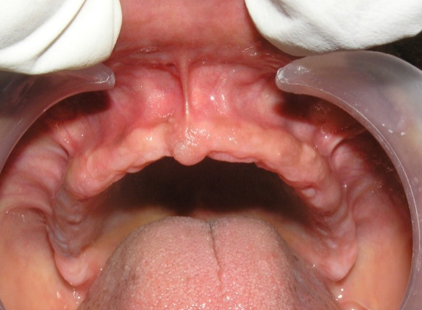
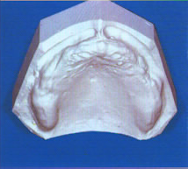
Labial Frenum:
Fibrous band covered by mucous membrane that extends the labial of the residual alveolar ridge to the upper lip.
It has no muscle fibers and presents a variable configuration from patient to patient i.e., Single or multiple. Inserts in a vertical direction
Best demonstrated by a forward pull -creates a thin v-shaped notch in the impression.

Slide 12
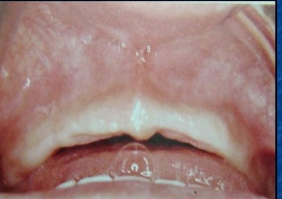
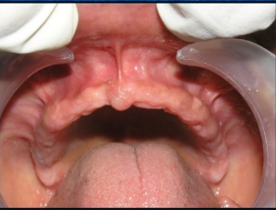
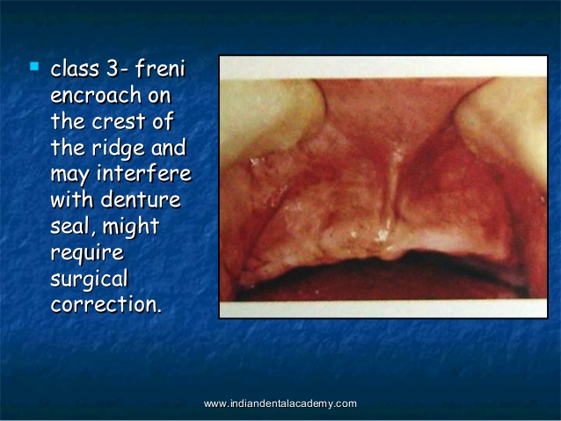
Labial Frenum:
House classified the frenal attachment into 3 classes.
Class 1 – high in maxilla or low in mandible
with respect to crest of ridge
Class 2 – Medium
Class 3 –freni encroach on the crest of the
ridge and may interfere with denture
seal, might require surgical correction

Slide 13
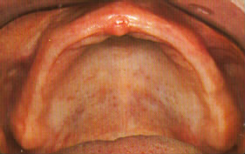
Labial vestibule:
The portion of oral cavity bounded on one side by the teeth, gingiva and alveolar ridge. (in the edentulous mouth the residual ridge) and on the other side by the lips, anterior to the buccal frenum.

Slide 14
Boundaries of labial vestibule:
1. Labial aspect of residual Alveolar ridge.
2. Mucolabial alveolar fold.
3. Orbicular Oris muscle (lip).
Reflection of mucous membrane superiorly determines the height.
The labial flange of maxillary denture occupies this space.

Slide 15
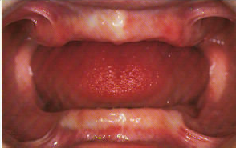
Buccal Frenum:
Single or multiple folds of mucous membrane and overlies levator angulioris muscle.
Varies in size and position, extends from mucous membrane lining of cheeks to alveolar mucosa.
Reflection is in an antero posterior direction.
Notch formed in the impression should allow the tissue movement in the area.

Slide 16
Buccal vestibule:
The portion of the oral cavity bounded on one side by the teeth, gingival and alveolar ridge (in the edentulous mouth the residual ridge) and on the lateral side, by the cheeks posterior to the buccal frenum.
Boundaries:
Anteriorly – Buccal Frenum.
Posteriorly – Hamular notch. (Pterygomaxillary notch).
Laterally - cheek.
Medially – residual ridge.
Buccal flange of the denture occupies this space.

Slide 17
Maxillary Tuberosity:
The most distal portion of the alveolar ridge.
It is the bulbous extension of the residual alveolar ridge in the second and third molar region terminating in the hamular notch (Pterygomaxillary notch).
Some times it would be necessary to reduce this area surgically before making the impression.

Slide 18
Pterygomaxillary notch: Hamular notch.
The palpable notch formed by the junction of the maxilla and pterigoid hamulus of the sphenoid bone.
The notch or cleft contains loose connective tissue.
Pterigomandibular ligament is attached to the hamulus.
The notch serves as anatomic guide to the posterior or distal extension of maxillary denture.

Slide 19
Posterior palatal seal area.
The soft tissues at or beyond the junction of the hard and soft palates on which pressure within the physiologic limits can be applied by a denture to aid in the retention.
It is distal to the hard and soft palate junction and area follows the contour of distal border of palatal bone.
This is the area where the artificial denture should terminate.
The denture edge usually ends at or before the vibrating line.

Slide 20
Vibrating line:
An imaginary line across the posterior part of the palate marking the division between the movable and immovable tissues of the soft palate, which can be identified when the movable tissues are functioning
Best demonstrated by the patient by sound – pronunciation “Ahhh” and more definitely by closure of nostrils.
Posterior palatal seal is located in an area of thick sub mucosa containing glandular and fatty tissues, which allows a selective pressure outline.

Slide 21
Fovea palatine:
Two small pits or depressions in the posterior aspect of the palate, one on each side of the midline at or near the attachment of soft palate to the hard palate.
The fovea are ductal openings into which the ducts of other palatal mucous glands open.

Slide 22
Median palatal suture:
Also termed as median raphe.
Extends from incisive papilla to distal end of hard palate.
It is covered with mucous membrane, which is closely attached, and little submucosal tissue.
The underlying sutural union is dense and often raised.
This area should be relieved on the maxillary denture to avoid denture movement and potential soreness.
Palatal torus may be present.

Slide 23
Rugae:
The irregular fibrous connective ridges located in the anterior third of the hard palate.
Rugae area is considered as secondary stress bearing area.

Slide 24
Incisive papilla:
The elevation of soft tissue covering the foramen of the incisive or nasopalatine canal.
It is located between the two central incisors on palatal side.
In the edentulous mouth it may be on the crest of the residual ridge.
It will often require relief in the finished denture.
Its position indicates amount of bone loss.

Slide 25
Residual ridge:
The portion of the alveolar process and its soft tissue covering that remains after removal of teeth.
The crest of the residual alveolar ridge is primary stress bearing area.
It is the area most tolerant to resisting denture movement and resulting irritation.
It is covered by a cornified stratified squamous epithelium over a dense collagenous submucosa and attached firmly to the underlying bone.

Slide 26
Residual ridge:
It is the area most tolerant to resisting denture movement and resulting irritation.
It is covered by a cornified stratified squamous epithelium over a dense collagenous submucosa and attached firmly to the underlying bone.

Slide 27
Stress bearing areas. Non stress bearing areas
Primary stress bearing area is ,
Residual alveolar ridge & Horizontal portion of the palate
Secondary stress bearing area is Palatal rouge.
Incisal Papilla, mid palatal suture, sharp bony prominence are non stress bearing areas.

Slide 28
TAKE HOME MESSEGE
Through understanding of the each landmark on the maxillary arch is very important while making comfortable dentures to the patients
Ensure the tissues are healthy before fabrication of new prosthesis.
Properly relief the area which is needed according the clinical significance, otherwise the dentures will not have good prognosis.

Slide 29
REFERENCES
Syllabus of Complete dentures, 3rd edition. 189-91.
Textbook of complete denture. Fifth Edition.Arthur O Rahn. 221-223.
Prosthodontic treatment of complete dentures. Zarb. Bolender, 211-232.

Slide 30
Question & Answer Session
Enumerate peripheral limiting structures of the maxillary edentulous arch
2. Enumerate stress and non stress bearing areas of the maxillary edentulous arch

Slide 31
THANK YOU

